Slide 1

By,
DANIEL RAJ A

Slide 2
Dream 11
Dream11 is a fantasy sports platform that allows users
to create virtual teams composed of real-life players from various sports leagues and competitions. Users can participate
in daily fantasy sports contests, where they compete against other users' teams based on the actual performance of the selected players in real-life matches.

Slide 3
Introduction to Design Thinking
Design thinking is a user-centric approach to problem-solving that emphasizes empathy, ideation, prototyping, and iteration.
Design thinking empowers businesses like Dream11 to create intuitive and engaging experiences that resonate with users.

Slide 4
Why Design Thinking Matters for Dream11
Dream11's success is rooted in its ability to provide an immersive fantasy sports platform. Design thinking enables Dream11 to continuously innovate and deliver personalized experiences that cater to the diverse needs of sports enthusiasts.

Slide 5
FOUNDING & HISTORY
Dream11 was founded in 2008 by Harsh Jain and Bhavit Sheth.
It started as a fantasy cricket platform and gradually expanded
to include other sports such as football, basketball, kabaddi,
hockey, and more.

Slide 6
DREAM11 SPORTS
Dream11 offers fantasy contests for a variety of sports, including cricket, football (soccer), basketball, kabaddi, hockey, volleyball, handball, baseball, rugby, and others. The availability of sports may vary based on the season and ongoing tournaments.

Slide 7
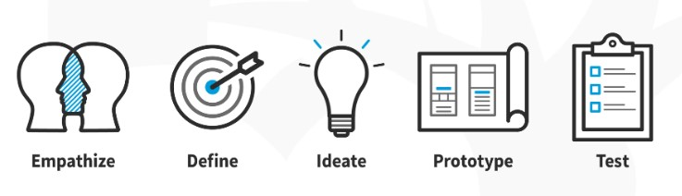
Empathize in dream11
This involves not just knowing who they are but also understanding their motivations, desires, and pain points. They would conduct user research, interviews, and surveys to gather insights into what sports fans want from a fantasy sports platform.

Slide 8
Define in dream11
Once Dream11 has a good understanding of its users, it would define the problem areas or opportunities. This might involve synthesizing the research findings into user personas, journey maps, and problem statements.

Slide 9
ideate in dream11
This is the stage where creativity comes into play. Dream11 would brainstorm potential solutions to the problems identified in the Define stage. This could involve techniques like brainstorming sessions, design sprints, or even hackathons where teams come up with innovative ideas to address user needs.

Slide 10
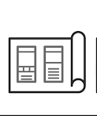
prototype in dream11
Once promising ideas have been generated, Dream11 would create prototypes to test them out. These could be low-fidelity prototypes like sketches or wireframes, or more high-fidelity prototypes like clickable mockups or even functional prototypes. The goal is to quickly iterate on ideas and get feedback from users.

Slide 11
test in dream11
Dream11 would then test these prototypes with real users to gather feedback. This could involve usability testing, A/B testing, or beta testing with a small group of users. The key is to see how well the prototypes address user needs and whether they perform as expected.

Slide 12
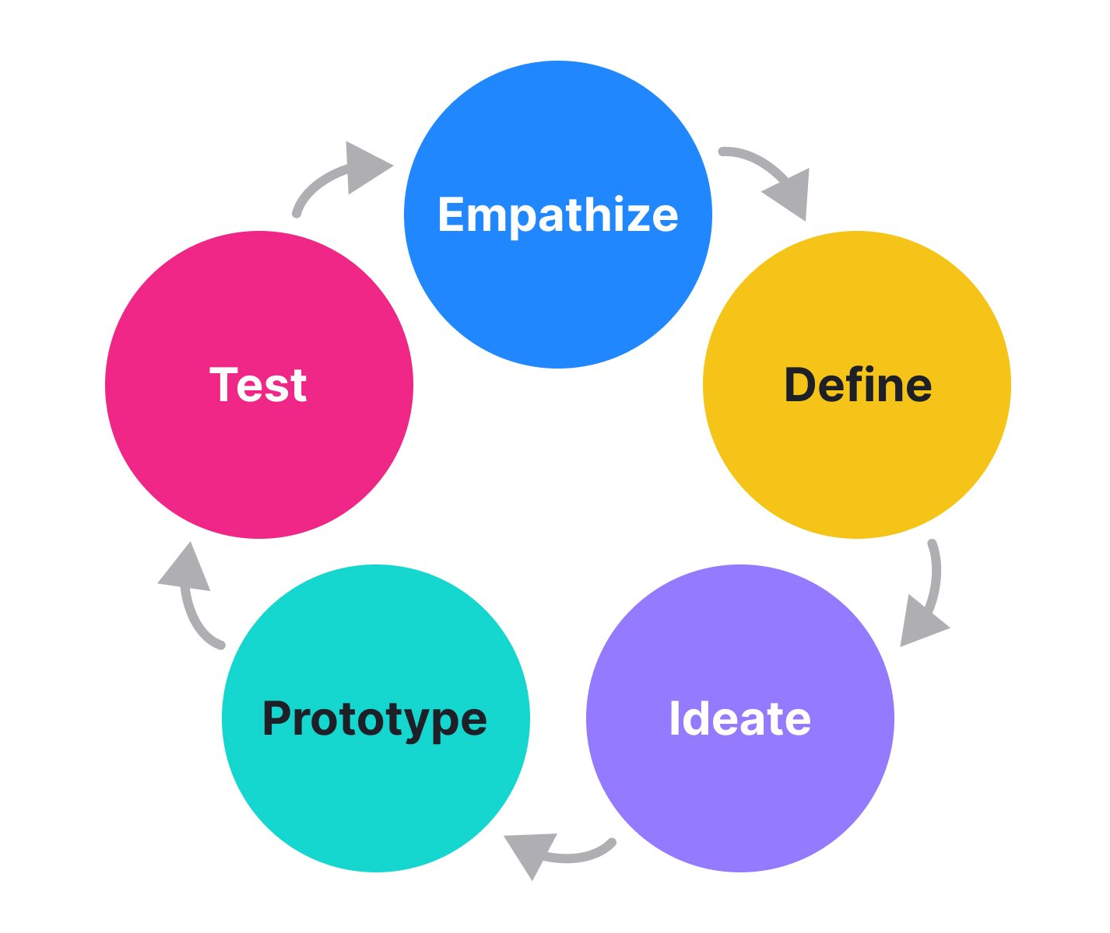
Iterate in dream11
Based on the feedback received during testing, Dream11 would iterate on the designs. This might involve refining existing features, discarding ideas that didn't work, or coming up with entirely new solutions based on user feedback. The iterative nature of design thinking ensures that the final product is truly user-centered.

Slide 13
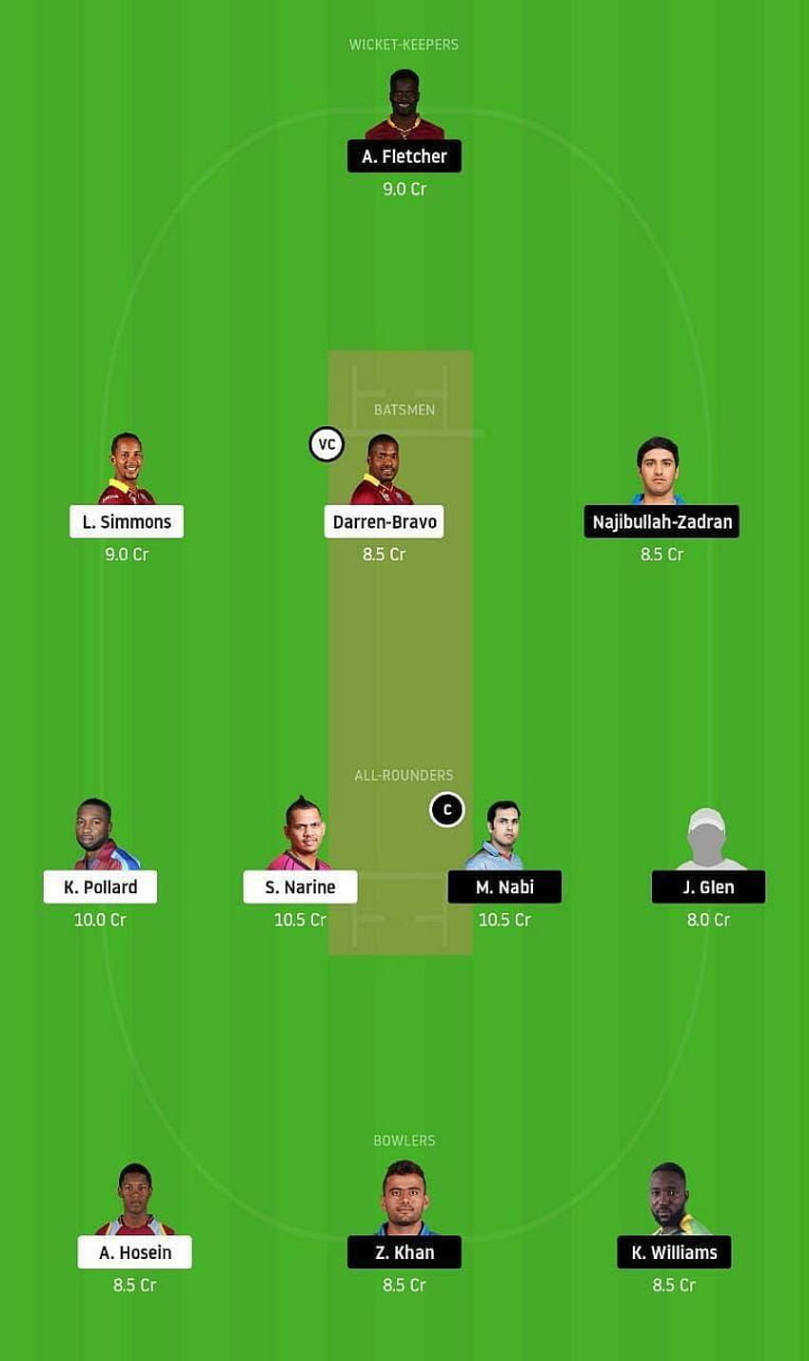
TEAM CREATION
Users are given a virtual budget to assemble their fantasy teams. They must strategically select players within the budget constraints, considering factors such as player performance, team composition, match conditions, and opponent strength.

Slide 14
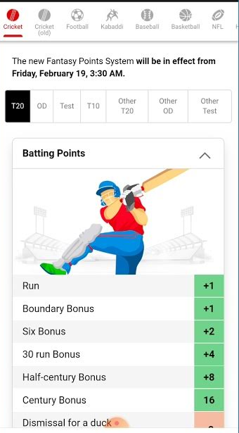
SCORING SYSTEM
Dream11 employs a scoring system for each sport, where points are awarded to users based on the performance of the selected players in real-life matches. The scoring parameters vary for each sport and include actions such as runs, wickets, goals, assists, catches, tackles, and more.

Slide 15

RANKING & PRIZES
At the end of the matches, users' fantasy teams are ranked based on their total points scored. Prizes are distributed to users based on their ranking in the contest, with higher-ranking teams often receiving larger prizes. Prizes may include cash rewards, merchandise, or other incentives.

Slide 16
LEGALITY
Fantasy sports platforms like Dream11 operate under the skill-based gaming exemption in many jurisdictions, including India, where they are considered legal. However, regulations may vary from region to region, and users are advised to familiarize themselves with the legalitie.

Slide 17


